Slide 1
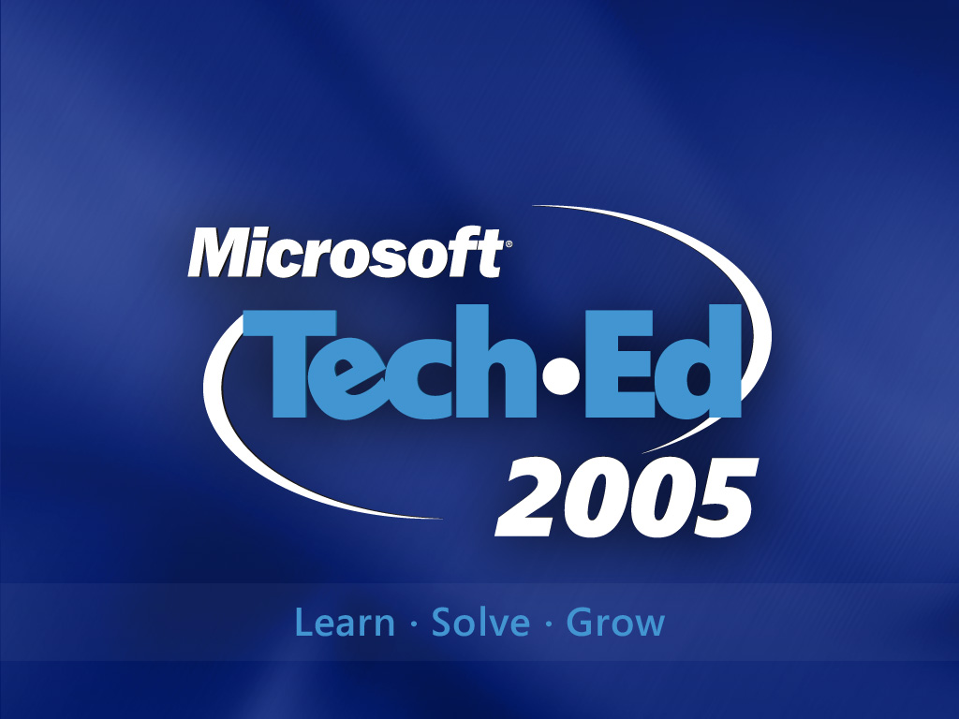

Slide 2

Security for Developers
Protecting Application Data
Steven Borg & Richard Hundhausen
Accentient, Inc

Slide 3

Agenda
Overview
Storing Private Data
  User Passwords
  Connection Strings
  Local Resources
Isolated Storage
Database Security
  SQL Server 2005 Security
Wrap Up
Notes:
In this session you will learn the fundamentals of building secure software. You will learn the basics of threat modeling and see some common coding defects that can expose your systems to risk. And of course you will learn how to mitigate the risks so you can ship secure software.
At the end there is also a short look at some good practices specifically for writing secure .NET code.

Slide 4
Agenda
Overview
Storing Private Data
  User Passwords
  Connection Strings
  Local Resources
Isolated Storage
Database Security
  SQL Server 2005 Security
Wrap Up
Notes:
In this session you will learn the fundamentals of building secure software. You will learn the basics of threat modeling and see some common coding defects that can expose your systems to risk. And of course you will learn how to mitigate the risks so you can ship secure software.
At the end there is also a short look at some good practices specifically for writing secure .NET code.

Slide 5
Protect Secrets & Offline Data
One-way hash functions
  Easy to compute, practically impossible reverse
    You cannot recover the source data from just its hash value!
  Best for: storing user passwords or other data where comparing hash values is sufficient
Strong encryption algorithms
  Ciphertext can be decrypted only if you know the encryption key
  Best for: protecting stored or transmitted data

Slide 6
Which Technique Should I Use?
I want to… | Recommendation | Advantages | Limitations
Store a user password securely | Salt + SHA1 (One-way hash) Prepend random salt to the passwords before hashing. | No keys to manage. | Identical input yields identical hash values. Must store the salt
Protect local user data | DPAPI (Encryption using keys derived from user credentials) | DPAPI manages keys on behalf of the application. | Data can’t be decrypted by other users, or on other machines.
Encrypt data that will need to decrypted later | Symmetric encryption algorithms (e.g. Rijndael) | Flexible: data can be decrypted by other apps / machines. | Application must manage keys and transmit them securely.

Slide 7
Agenda
Overview
Storing Private Data
  User Passwords
  Connection Strings
  Local Resources
Isolated Storage
Database Security
  SQL Server 2005 Security
Wrap Up
Notes:
In this session you will learn the fundamentals of building secure software. You will learn the basics of threat modeling and see some common coding defects that can expose your systems to risk. And of course you will learn how to mitigate the risks so you can ship secure software.
At the end there is also a short look at some good practices specifically for writing secure .NET code.

Slide 8
Securing Data
User Passwords
Goal: Keep user passwords safe, but usable
Recommendation: Hash (Salt + Password)
Storing a password:
  1. Create a unique “salt” for the user
  2. Prepend the salt to the password string
  3. Encrypt using SHA1 / MD5:
  4. Store both salt and cipher text
To verify, re-hash with salt and password
Notes:
A “salt” ensures a unique encrypted password cipher is stored for each user, even if two users choose exactly the same password. For example, if two users pick the password string “password” the one way hash generated for the word “password” will be the same. By adding the salt value to the string “password” the two users will have a unique cipher stored in the database, despite having the same password.

Slide 9
Storing Login Passwords
Don't store passwords in login databases
Store password hashes for added security
Salt hashes to impede dictionary attacks
Format | Comments
Plaintext passwords | Exposes entire application if database is compromised
Encrypted passwords | Better than plaintext, but still vulnerable if decryption key is compromised
1-way password hashes | Better than encrypted passwords, but still vulnerable to dictionary attacks
Salted password hashes | Less vulnerable to dictionary attacks
Notes:
Windows stores password hashes, not encrypted passwords, for added security
Encrypted passwords are required if you want the capability to e-mail forgotten passwords to users (a requirement of the OpenHack competition)
"Salting" means appending a random value to a password before hashing it. Typically, a unique salt is generated for each password and the salt is stored along with the password hash. If an attacker manages to grab the entire database, a single query will no longer retrieve all the records with a given password. The more passwords there are, the more effective the salts because a larger number of random salts yields a larger effective key space

Slide 10
Generating Password Hashes
Generate a Hash using FormsAuthentication
string hash = FormsAuthentication.
HashPasswordForStoringInConfigFile(password,
"SHA1"));
Notes:
The .NET Framework currently doesn't contain a 1-stop method for generating salted password hashes. However, the supplementary slides at the end of this deck include code samples demonstrating how to generate and validate salted password hashes using FormsAuthentication.HashPasswordForStoringInConfigFile

Slide 11

Generating Password Hashes
Generate a Hash using FormsAuthentication
string hash = FormsAuthentication.
HashPasswordForStoringInConfigFile(password,
"SHA1"));
NO! Use a SHA-256 for more security
// create a stronger hash for more security
byte[] myHash = new SHA256Managed().ComputeHash(data);
Notes:
The .NET Framework currently doesn't contain a 1-stop method for generating salted password hashes. However, the supplementary slides at the end of this deck include code samples demonstrating how to generate and validate salted password hashes using FormsAuthentication.HashPasswordForStoringInConfigFile

Slide 12
Securing Data
Connection Strings
Storing plaintext database connection strings in Web.config is risky
  Vulnerable to file disclosure attacks
Storing encrypted database connection strings increases security
Encrypting connection strings is easy
  System.Security.Cryptography classes
Key management is not
  Where do you store the decryption key?
Notes:
Key management is a BIG DEAL because if you can't store the key securely, encryption is worthless

Slide 13
Data Protection API (DPAPI)
Extends CryptoAPI
    Key is derived from current user credentials
    Uses TripleDES encryption
Supports entropy
  Additional secret used
  to secure the data to a single application
Best for:
  Protecting offline data
  Protecting user-specific configuration data
Application
DataProtection.vb
Plaintext data
Now is the
time for all
good…
qANQR1D
BAsUHIsQ
EA…
Operating
System
DPAPI
CryptoAPI
Crypt32.dll
Local RPC
Calls
DPAPI
Local Security
Authority (LSA)
Notes:
DPAPI is a bolt-on to the .NET Framework, since it does not include this support. The DataProtection.vb helper library in IssueVision is an extension of a commonly used version originally authored by Microsoft’s security expert, Michael Howard.

Slide 14
Data Protection API (DPAPI)
Present in Windows 2000 and higher
Provides strong encryption, automatic key generation, and secure key storage
  Triple-DES encryption
  PKCS #5 key generation
Two “stores”:
  User store – Per-user keys based on profiles
  Machine store – Per-machine keys with optional entropy values
Notes:
The BIG WIN with DPAPI is that it offloads the task of key management to the operating system
ASP.NET doesn't map very well to the user store because all ASP.NET apps run under one user profile. ASP.NET maps very well to the machine store, which doesn't rely on user profiles
The downside to the machine store is that data encrypted by one app can be decrypyted by another. Use per-application entropy values if you wish to privatize keys stored in the machine store.
Remember that entropy values are keys that must be stored securely just like other secrets! ACLed registry keys are one place to store entropy values

Slide 15
Building a DPAPI Library
.NET FCL 1.x doesn't wrap DPAPI
See “How to Create a DPAPI Library” for instructions on creating your own library
  Or download from http://blog.accentient.com
Managed wrapper around DPAPI
  Handles interop and marshaling for you
  Features DataProtector class with simple methods named Encrypt and Decrypt
  Supports machine store and user stores
Notes:
This wrapper library makes using DPAPI extremely easy but also requires that the calling app have permission to call unmanaged code

Slide 16
Securing Connection Strings
Description | Security
Store encrypted connection strings in Web.config Store key in ACLed registry entry | Good
Store encrypted connection strings in Web.config Let DPAPI perform key management | Better
Store encrypted connection strings in ACLed registry key Let DPAPI perform key management | Better
Store encrypted connection strings in ACLed registry key Let DPAPI perform key management Use entropy values to harden DPAPI encryption Store entropy values in ACLed registry key | Best
Notes:
The Microsoft Reference Application for OpenHack (MRAO) presented in session 4 uses the "Best" approach

Slide 17
Encrypting Connection Strings
Web.config
<configuration>
<appSettings>
<add key="ConnectionString"
value="AQNCMnd8BFdERjHoAwE/Cl+sBAAAA..." />
</appSettings>
</configuration>
Page
DataProtector dp = new DataProtector
(DataProtector.Store.USE_MACHINE_STORE);
string val = ConfigurationSettings.AppSettings
["ConnectionString"];
byte[] data = Convert.FromBase64String (val);
string connect = Encoding.ASCII.GetString
(dp.Decrypt (data, null));
Notes:
Lines in the Web.config file above are artificially broken for formatting purposes
The code sample above utilizes the DataProtector class in the library referenced on the previous slide

Slide 18
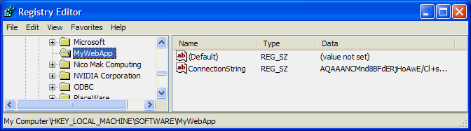
Encrypting and ACLing Connection Strings
Registry
Admins: Full
SYSTEM: Full
ASP.NET: Read
Page
DataProtector dp = new DataProtector
(DataProtector.Store.USE_MACHINE_STORE);
RegistryKey key = Registry.LocalMachine.OpenSubKey
("SOFTWARE\\MyWebApp");
string val = (string) key.GetValue ("ConnectionString");
byte[] data = Convert.FromBase64String (val);
string connect = Encoding.ASCII.GetString
(dp.Decrypt (data, null));
Notes:
The code sample above utiliizes the DataProtector class in the library referenced two slides ago

Slide 19


Securing a Connection String
Notes:
<footer>© 2005 Microsoft Corporation. All rights reserved.
This presentation is for informational purposes only. Microsoft makes no warranties, express or implied, in this summary.

Slide 20
Securing Data
Local Resources
What is a local resource?
    Files and File System
    Registry Information
    User Interface elements
    Clipboard
    Network access (e.g. Web, sockets)
    Performance counters, event logs
    Printing, and more
Windows controls access using ACLs
.NET controls access with Code Access Security

Slide 21
Code Access Security
Provides fine-grained access control to resources
  Applications can run with "just enough” permissions
    For example: Applications which don’t perform any File IO run without File IO Permission
Grants access to resources based on the identity of the code, not the user
  Uses evidence to determine code identity
  Uses policy to evaluate the evidence to determine which permissions will be granted to the application.

Slide 22


Evidence + Policy = Permissions
Load Assembly
Hash
Strong name
Publisher
Zone URL
Gather Evidence
Enterprise
Machine
User
AppDomain
Grant Permission Sets
(yielding permissions)
Assembly performs privileged operation
Demand Permission
Continue with Privileged Operation
(or access resource)
permission
granted?
Yes
No
Throw Security Exception
Notes:
Once the identity of a piece of code has been determined, the associated security policy is used to determine which permissions are granted to the application.
http://msdn.microsoft.com/library/default.asp?url=/library/en-us/dnnetsec/html/THCMCh08.asp

Slide 23
Agenda
Overview
Storing Private Data
  User Passwords
  Connection Strings
  Local Resources
Isolated Storage
Database Security
  SQL Server 2005 Security
Wrap Up
Notes:
In this session you will learn the fundamentals of building secure software. You will learn the basics of threat modeling and see some common coding defects that can expose your systems to risk. And of course you will learn how to mitigate the risks so you can ship secure software.
At the end there is also a short look at some good practices specifically for writing secure .NET code.

Slide 24

Isolated Storage
Provides a virtual file system
Allows quotas
Implements file system isolation based on:
  Application identity
  User identity
  IsolatedStorageFile isoStore =
  IsolatedStorageFile.GetUserStoreForAssembly();

Slide 25
Isolated Storage
Apps often need to write some data locally, and, perhaps, even leave it there
What should we use?
  Registry? No.
  File system? Maybe for documents.
  Isolated storage? Yes!
Isolated Storage allows a trusted assembly to store data on a client machine
  Standard file IO operations are not used
  Permission to access the local file system not required
Notes:
<footer>© 2005 Microsoft Corporation. All rights reserved.
This presentation is for informational purposes only. Microsoft makes no warranties, express or implied, in this summary.

Slide 26
Isolated Storage
A virtual file system
  May have its own folder structure
  Files may have data of almost any kind
Data is kept in a “Store”
Stores are isolated by scope
    Can be by assembly, domain, user…
    Size may be limited by setting a quota
Physical location is managed by the system and depends on OS, but typically:
  Documents and Settings or Profiles etc. folders
  If you have roaming profiles, Isolated Storage will roam with the user to each computer they access
Notes:
<footer>© 2005 Microsoft Corporation. All rights reserved.
This presentation is for informational purposes only. Microsoft makes no warranties, express or implied, in this summary.

Slide 27
Isolated Storage Practices
Use isolated storage to store:
  User settings
  Data caches
  Queued information waiting for a connection to submit to a web service
Do not use isolated storage for:
  User documents that they may need to find with Windows Explorer.
  Secret information. Isolated storage is not encrypted, so don't store plain text passwords.
Notes:
<footer>© 2005 Microsoft Corporation. All rights reserved.
This presentation is for informational purposes only. Microsoft makes no warranties, express or implied, in this summary.

Slide 28
Isolated Storage
Notes:
<footer>© 2005 Microsoft Corporation. All rights reserved.
This presentation is for informational purposes only. Microsoft makes no warranties, express or implied, in this summary.

Slide 29
Agenda
Overview
Storing Private Data
  User Passwords
  Connection Strings
  Local Resources
Isolated Storage
Database Security
  SQL Server 2005 Security
Wrap Up
Notes:
In this session you will learn the fundamentals of building secure software. You will learn the basics of threat modeling and see some common coding defects that can expose your systems to risk. And of course you will learn how to mitigate the risks so you can ship secure software.
At the end there is also a short look at some good practices specifically for writing secure .NET code.

Slide 30
Secure the Database
Use the least-privileged account possible to connect to the database
Limit access privileges to stored procedures only
  If stored procedures can’t be used, use type-safe parameters to construct commands
Protect connection strings as secrets
Encrypt sensitive data to be retrieved from the database using strong symmetric encryption
  Then, encrypt symmetric encryption keys with DPAPI, and store these in a restricted registry key
Notes:
The key points to securing the database are these:
allow the application to access the data in the most restricted way that works. Limit privileges for the account it uses to only the stored procedures it uses.
NEVER “sa”
protect connection strings as a secret
encrypt sensitive data before storing it in the database
"symmetric" is being used to imply that you should be using a subclass of System.Security.Cryptography.SymmetricAlgorithm (for example System.Security.Cryptography.RijndaelManaged).

Slide 31
Tip: Different Logins by Task
“sa” (or equivalent domain account)
  Database server administrator
  Used to create database only
“dbo"
  Owner (dbo) for the application database
  Used for application development only
    Modify schema, creating stored procedures
“IVUser“
  Locked-down account
  Used by middle-tier components to access the stored procedures

Slide 32


SQL Server 2005 Security
Many security improvements
  User Passwords
  Key Management
  Encryption / Decryption
  Schemas

Slide 33
User Passwords
User passwords can be forced to abide by the Active Directory password strength rules

Slide 34
Key management
Encryption keys can be stored in the database
  symmetric keys
  asymmetric keys
Encryptions keys used for
  data encryption - symmetric keys
  validation of unsafe assemblies - asymmetric keys
MASTER KEY must be defined before symmetric
  used to encrypt other symmetric keys

Slide 35
Encryption and decryption
SQL Server 2005 improves encryption and decryption
  can encrypt by certificate
  can encrypt by key
  can encrypt by pass phrase
Encryption can be used to secure column values
  e.g. credit card numbers

Slide 36
Schemas
SQL Server 2005 allows multiple schemas in database
  schemas exist independent of users
Schema name can be substituted for user name in object
  eases database management when personnel changes
Objects in schema cannot be "inventoried" by public
  names are secure; prevent typical step in compromise

Slide 37
Create schema with name
CREATE SCHEMA name creates a schema
  has name that is stored in sys.schemas
  like other DDL permission required to use
  Example: Research.Scientist
Like other objects schema has owner (AUTHORIZATION)
  owner can be user, role, or approle

Slide 38
SQL Server permissions
Users that are not schema owner must have permissions
  permissions granted to user, role, or approle
  can use GRANT, REVOKE, DENY DDL verbs
Permission can be granted to use DDL
  CREATE, GRANT with GRANT option
Permissions can be granted to objects directly
  SELECT, INSERT, UPDATE, DELETE
Permissions can be granted to code that accesses objects

Slide 39
SQL Server 2005 Security
Notes:
<footer>© 2005 Microsoft Corporation. All rights reserved.
This presentation is for informational purposes only. Microsoft makes no warranties, express or implied, in this summary.

Slide 40
Agenda
Overview
Storing Private Data
  User Passwords
  Connection Strings
  Local Resources
Isolated Storage
Database Security
  SQL Server 2005 Security
Wrap Up
Notes:
In this session you will learn the fundamentals of building secure software. You will learn the basics of threat modeling and see some common coding defects that can expose your systems to risk. And of course you will learn how to mitigate the risks so you can ship secure software.
At the end there is also a short look at some good practices specifically for writing secure .NET code.

Slide 41
Wrap Up
Hash passwords for storage
Don’t be afraid of DPAPI
  NCrypto from SourceForge
Use ACLs to control access to local resources
Use Isolated Storage
  For partially trusted code (i.e., Web)
  For user convenience and light security
Use database security best practices
Notes:
In this session you will learn the fundamentals of building secure software. You will learn the basics of threat modeling and see some common coding defects that can expose your systems to risk. And of course you will learn how to mitigate the risks so you can ship secure software.
At the end there is also a short look at some good practices specifically for writing secure .NET code.

Slide 42
Resources
Steve’s Blog: http://blog.accentient.com
Rich’s Blog: http://blog.hundhausen.com
Security Book / Wiki: http://www.winsecguide.net
DPAPI: http://sourceforge.net/projects/ncrypto/
SQL Server 2005: http://www.microsoft.com/sql/2005/default.asp

Slide 43


Your Feedback
is Important!
Please Fill Out a Survey for
This Session on CommNet

Slide 44

© 2005 Microsoft Corporation. All rights reserved.
This presentation is for informational purposes only. Microsoft makes no warranties, express or implied, in this summary.
Notes:
<footer>© 2005 Microsoft Corporation. All rights reserved.
This presentation is for informational purposes only. Microsoft makes no warranties, express or implied, in this summary.

